Slide 1





Week 6: K-Means Clustering
Notes:
Hello, everyone. Welcome to MUDSS Advanced Workshop on K-Means Clustering.

Slide 2
OVERVIEW
Brief recap of Unsupervised learning and Clustering
Introduction to K-Means Clustering Principle and K-Means Algorithm
K-Means Related Problems:
Evaluating model performance
Determining optimal K value
K-Means Clustering Implementation
Implementation using sklearn
K-Means Improvement:
K-Means++: Reduce the sensitivity of the selection of initial cluster centroids
K-Medoids: Reduce the sensitivity of noise and unusual data points
Summary
Notes:
In this workshop, we will start from introducing the definition of unsupervised learning and clustering. After that, we will explain the principle of K-Means Clustering algorithm and the algorithm’s general procedure.
Then, we are going to discuss how to evaluate our clustering algorithm and how to choose the only hyper parameter k.
Then, we are going to demonstrate how to use sklearn to implement K-Means algorithm together with some randomly generated data.
Finally, we will discuss pros and cons of K-Means algorithm, and introduce two improved algorithms: K-Means++ and K-Medoids.

Slide 3
Unsupervised Learning
What is unsupervised learning?
Unsupervised learning uses machine learning algorithms to analyze and cluster unlabeled datasets.
These algorithms discover hidden patterns or data groupings without the need for human intervention.
Notes:
We begin with introducing the notion of unsupervised learning. Basically, ”unsupervised” means the given dataset is not labeled, and “learning” means uses given dataset to dig out a pattern or knowledge, and use such pattern or knowledge to solve incoming problems.
What’s more, unsupervised learning algorithms has no clear goal and its performance is difficult to evaluate, which is completely different to supervised learning.
For supervised learning algorithms, their input dataset are classified, tagged in advance, and we have a clear goal for training the model, such as for classifiers which is responsible for classify datapoints to one certain category, we want our model to be as precise as possible, and its performance can be assessed by checking how accurate its classification is on test datasets.
Common unsupervised learning algorithms including clustering algorithms and data compression algorithms, such as K-Means Algorithm, Hierarchical Clustering and PCA. Today, we are going to think about clustering algorithms.

Slide 4
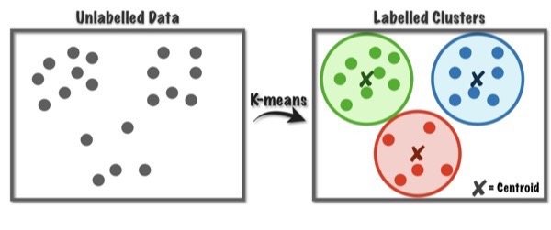
Clustering
Conventional Definition:
Formal Definition:
Clustering is the task of dividing a bunch of datapoints into different groups.
Clustering is the process of dividing a set of datapoints into several subsets, so that elements
from the same subsets are similar while elements from different subsets have no resemblance.
Notes:
To begin with, we need to understand what clustering is. Essentially, it is the process of dividing a set of datapoints into several subsets, so that points in the same group are similar in some ways but points in different groups are not.

Slide 5
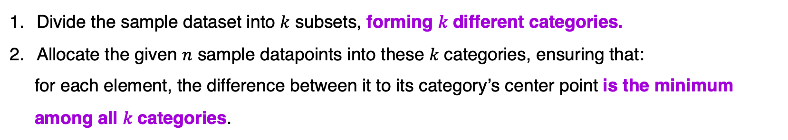
K-Means Principle
The assumption of K-Means:
The principle of K-Means is Division:
The general idea of K-Means:
Each sample datapoint only belongs to one category, categories are disjoint sets.
Divide datapoints into several categories based on their similarity.
Divide the sample dataset into $k$ subsets, forming 𝑘 different categories.
Allocate the given $n$ sample datapoints into these 𝑘 categories, ensuring that:
for each element, the difference between it to its category’s center point is the minimum
among all 𝑘 categories.
Notes:
In K-Means clustering, we assign every datapoints in the given training dataset to one specific cluster, but each datapoint can belongs to only one.
We also know, for K-Means clustering (actually, for every kind of clustering algorithms), we gather similar datapoints together to form clusters. Therefore, we need to think about how can we model “similarity” between datapoints, which is going to be discussed in the next slide.

Slide 6
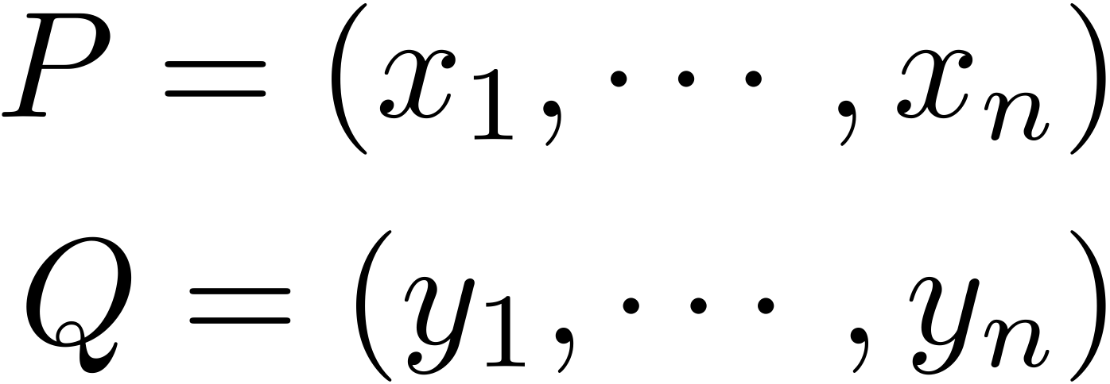
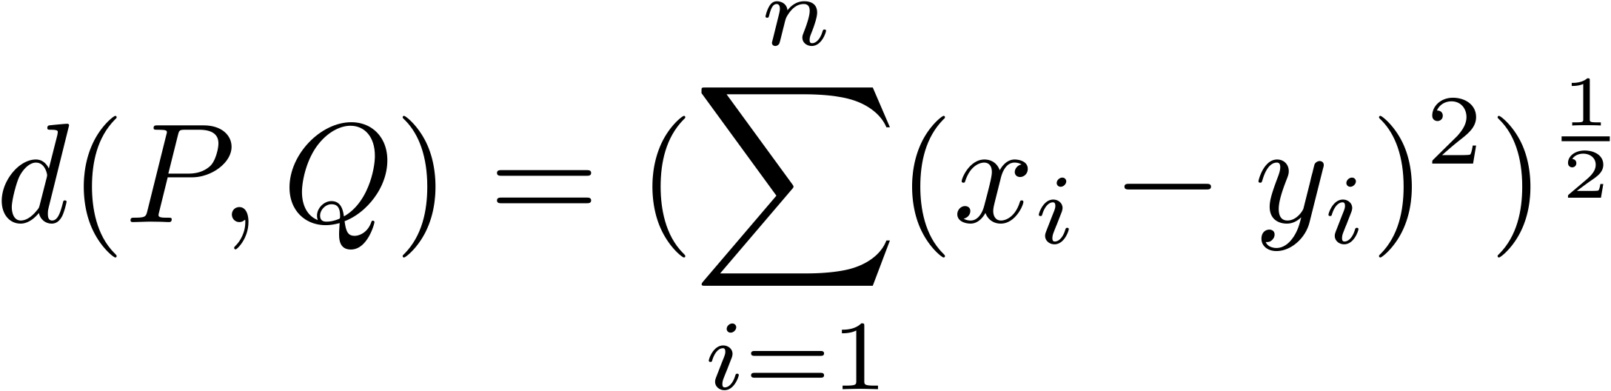
K-Means Principle
Problem: How do we quantify similarity ?
K-Means Algorithm applies Measurement on Distance to check the similarity.
 | Principle | Representatives
Measurement on Distance | The smaller the distance is, the greater the resemblance will be | Euclidean Distance
Measurement on Angle | The smaller the angle is, the greater the resemblance will be | Cosine Similarity
In K-Means Algorithm, the definition of distance it used is Euclidean Distance.
Notes:
It turns out that we can model similarity using two ways. The first way, which is actually used in our algorithm, is the measurement on distance. This modeling assumes that the smaller the distance between two points is, the more similar these two points are. In K-Means Algorithm, we check two datapoints’ Euclidean distance to see how similar they are.
An alternative is the measurement on angle, which is usually used on vectors.

Slide 7
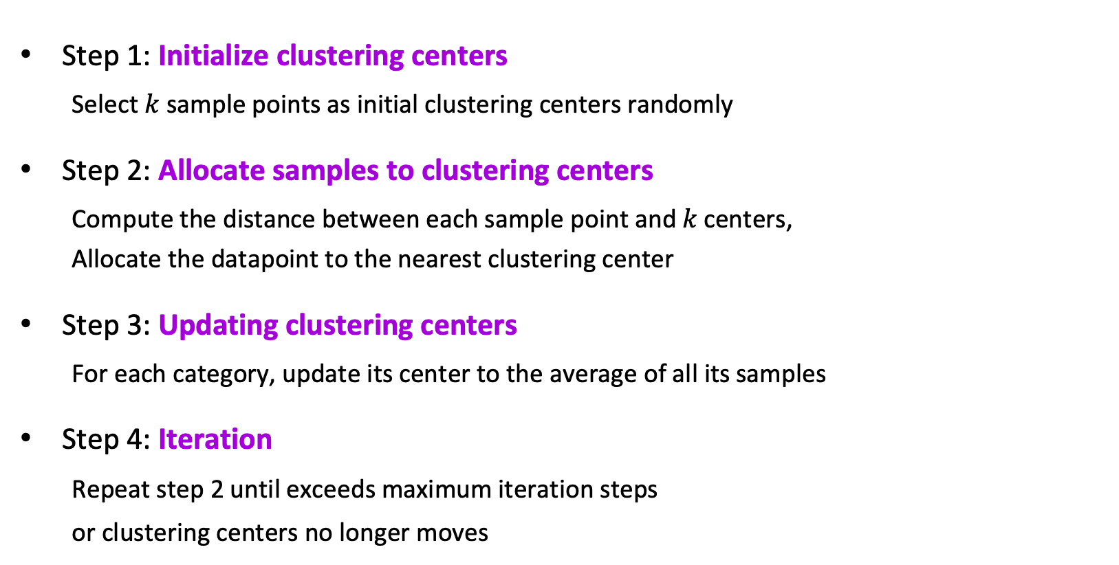
K-Means Algorithm
Step 1: Initialize clustering centers
Select $k$ sample points as initial clustering centers randomly
Step 2: Allocate samples to clustering centers
Compute the distance between each sample point and 𝑘 centers,
Allocate the datapoint to the nearest clustering center
Step 3: Updating clustering centers
For each category, update its center to the average of all its samples
Step 4: Iteration
Repeat step 2 until exceeds maximum iteration steps
or clustering centers no longer moves
⌘ 𝑘 needs to be determined in advance
⌘ The selection of initial clustering
centers will affect the outcome
⌘ Maybe some clusters got no points
(sklearn basically wrapped up everything for us!)
Notes:
K-Means algorithm is divided to two parts: initialization and iteration. During the initialization process, the first k clustering centroids will be assigned, the re-allocation of datapoints and optimization of the selection of clustering centroids will be performed in iteration.
There are several things to be considered:
1. Firstly, number k is the only hyper parameter that needs to be determined in advance. We’ll discuss how to select this value later on.
2. Secondly, the selection of initial clustering centers is crucial to get a good result. Usually we use K-Means++ to select initial clusters, which we will also talk about later.
3. In some cases, when re-allocating samples in step 2, we may encounter the case that some clusters has no other samples at all. In this case, we usually just remove this cluster.
So that’s it. We initialize k cluster centers based on some principle or completely by random in the beginning, then allocate other data points to k clusters, update each cluster’s center, then iterate again. By the updating of our cluster centers, the accuracy of our clustering will become better: different clusters are going to “move further from each other”, and clusters tends to become more dense.

Slide 8
K-Means Principle and Algorithm
Conclusion:
The way K-Means Measure Similarity | Euclidean Distance
The way categories are represented | The average of the cluster
The loss function of K-Means | The sum of distance between each point to its cluster’s centroid
Using Iteration to achieve local optimality | Using Iteration to achieve local optimality
Notes:
To conclude, K-Means Clustering works by cluster similar datapoints together to form clusters, during this process it recognizes the “similarity” between datapoints to be their Euclidean distance.
The representative it chooses is the average of every datapoint in the cluster, which may end up being one of the datapoints in the cluster, or something does not belong to it.
It’s loss function is simply the sum of distance between each datapoint to its cluster’s center. By iterating to update the center of each cluster based on the previous re-clustering result, the sum of the distance will become smaller and smaller, finally reached the local minimum.

Slide 9
Some Problem…
Evaluate model’s performance
Determine 𝑘 value
Both SSE (Sum of Squad Errors) and Silhouette Coefficient can be used to evaluate whether our K-Means clustering is a good one or not.
The smaller one’s SSE is, the better its clustering effect will be.
The bigger one’s Silhouette Coefficient is, the better its clustering effect will be.
Usually, we combine these two factors to evaluate one K-Means clustering’s performance.
We can use either Elbow Method or Silhouette Method to determine the optimal value of 𝑘.
Note that The Elbow Method and the Silhouette Method are not alternatives: they are tools which is to be used together to provides us with a more confident decision.
Check Jupyter Notebook
Notes:
Before starting to implement it, we need to think about how to evaluate the clustering model and how can we determine an appropriate k. Essentially, the parameter we used to evaluate model’s performance and determining k is identical: either by using SSE or evaluate Silhouette Coefficient. We are going to discuss it further in the Jupyter Notebook.

Slide 10
Problem Resolving & Implementation
Notes:
Then we are going to solve the problems above and implement K-Means algorithm in Jupyter Notebook.

Slide 11
Improvements
Pros and cons of K-means Algorithm:
Advantages
1. Principle is simple, Easy to implement, Converges very fast
2. The clustering effect is overall pretty good
3. The model is easy to explain
4. The only hyper parameter needs to be adjusted is variable k
Drawbacks
1. Selecting value k is usually not an easy task
2. Sensitive to initial clustering centroids
3. Using iteration to optimize solution, may got local optimal solutions.
4. Sensitive to noise or exceptional datapoints
We will briefly talk about improvements on drawback 2 and 4 today.
Notes:
Then we go back to discuss the pros and cons of K-Means Algorithm.
On the positive side, it’s simple in principle therefore relatively easy to implement. Since it has a reasonable assumption, its clustering effect is usually pretty good as long as you choose an appropriate k value.
Unlike artificial neural networks, The model is not a black box, It’s also not difficult for us to explain its result or the model itself.
It’s also not very dependent on human intervention since it’s an unsupervised learning algorithm, what we need to do is just specify the hyper parameter k, then K-Means algorithm will perform the rest automatically for you.
However, just as we seen, selecting an optimal k is not an easy task.
What’s more, it’s also sensitive to the initial clustering centroids, the difference on it will result in completely different results.
To make things worse, just like any other optimization algorithms using iteration, it’s possible for K-Means to falls in a local-optimal plane and being unable to figure out the global optimal solution.
Finally, since K-Means algorithm chooses the average of all points in one cluster as its centroid, when the cluster contains some exceptional data, the centroid will be significantly affected therefore results in a biased selection on centroid.
Next, we are going to talk about ways of resolving drawback 2 and 4.

Slide 12
Resolving issues:
Sensitive to the selection of initial clustering centers
Sensitive to noise and unusual datapoints
The clustering result of conventional K-Means algorithm will be affected by the choice of initial clustering centers.
One workaround to this issue is K-Means++:
Ensuring the initial clustering centroids are as far from each other as possible.
K-Means algorithm choose The average of every cluster’s datapoints to be its center, making the choice of center points susceptible to datapoints with extreme values since they distort data distribution.
One workaround is K-Medoids:
Choose the data point which has the smallest distance to the cluster’s center,
instead of directly setting the mean to be the centroid
Check Jupyter Notebook
Notes:
The second drawback is related to the selection of initial clustering centers. From our understanding, good clustering centers should be as far from each other as possible, that’s what K-Means++ do. It uses some probabilistic method to ensure that none of the clustering centroid pairs are too close to each other.
The last drawback is related to the way we update clustering centroids. One workaround is to limit the selection of our centroids in the scope of data points belonging to this cluster. This approach is called K-Medoids.
Then We are going to take a close look at their principle and implementation in the jupyter notebook.

Slide 13
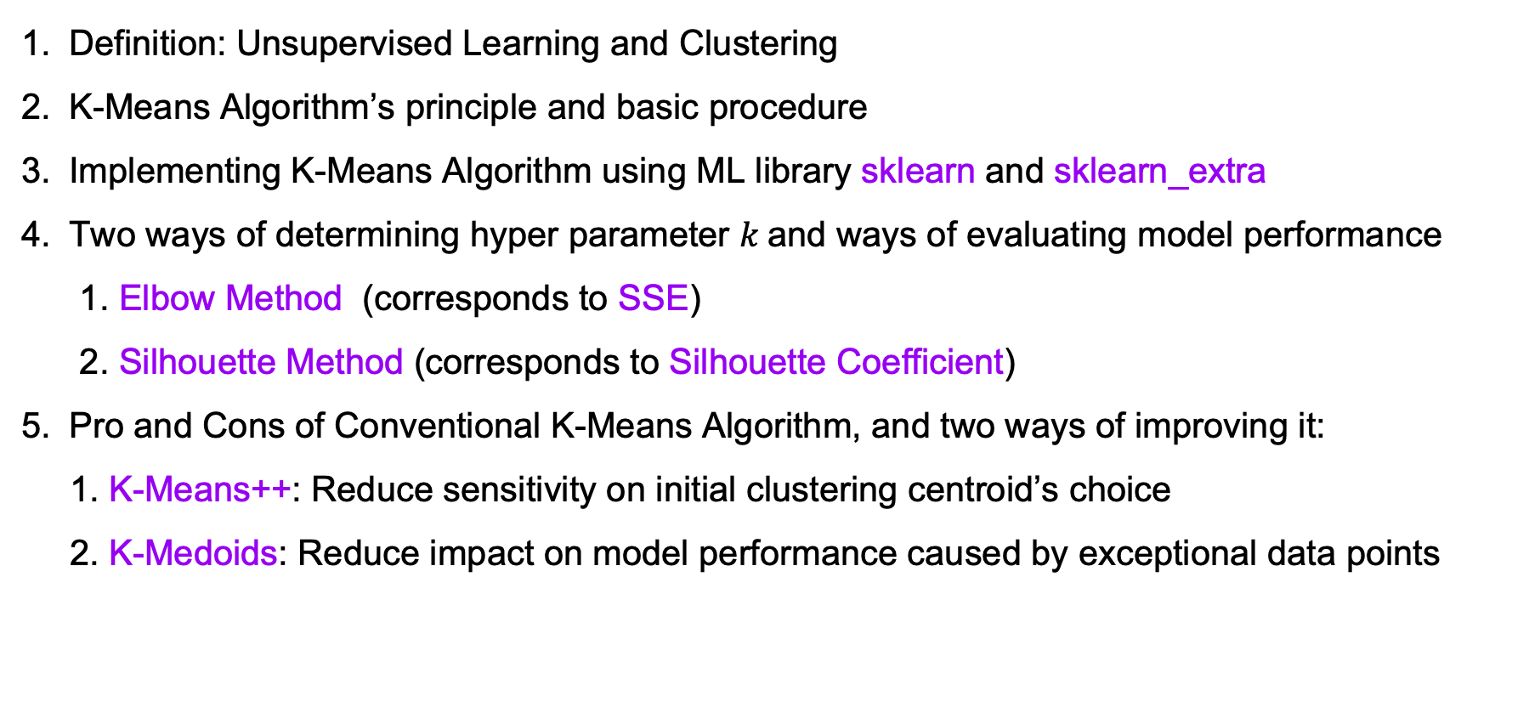
SUMMARY
Definition: Unsupervised Learning and Clustering
K-Means Algorithm’s principle and basic procedure
Implementing K-Means Algorithm using ML library sklearn and sklearn_extra
Two ways of determining hyper parameter $k$and ways of evaluating model performance
1. Elbow Method (corresponds to SSE)
2. Silhouette Method (corresponds to Silhouette Coefficient)
Pro and Cons of Conventional K-Means Algorithm, and two ways of improving it:
1. K-Means++: Reduce sensitivity on initial clustering centroid’s choice
2. K-Medoids: Reduce impact on model performance caused by exceptional data points
Notes:
To summarize, today we learned the definition of unsupervised learning and took a brief look at one subject of it: clustering. We introduced K-Means clustering algorithm, explained its principle, learned how it works and what its basic procedure is.
We also learned how to determine the only hyper parameter k using elbow method and silhouette method, and what insight on our model’s performance we can gain from looking at its SSE and Silhouette coefficient.
We also implemented K-Means++ and K-Medoids using science kit library sklearn and sklearn_extra respectively.
Finally, we discussed the pros and cons of K-Means Algorithm, and introduced two of its improved version: K-Means++ and K-Medoids.

Slide 14
REFERENCES:
https://www.ibm.com/cloud/learn/unsupervised-learning
https://zhuanlan.zhihu.com/p/158776162
https://www.analyticsvidhya.com/blog/2019/08/comprehensive-guide-k-means-clustering/
https://towardsdatascience.com/understanding-k-means-clustering-in-machine-learning-6a6e67336aa1
https://medium.com/geekculture/why-do-initial-cluster-centroids-in-k-means-affect-the-final-cluster-generated-71c115141be8
https://medium.com/analytics-vidhya/how-to-determine-the-optimal-k-for-k-means-708505d204eb
http://ilpubs.stanford.edu:8090/778/1/2006-13.pdf
https://scikit-learn-extra.readthedocs.io/en/stable/auto_examples/plot_kmedoids.html#sphx-glr-auto-examples-plot-kmedoids-py
https://www.cnblogs.com/yixuan-xu/p/6272208.html
Notes:
Thank you for your listening, If you have any questions, please don’t hesitate to ask.

